Slide 1
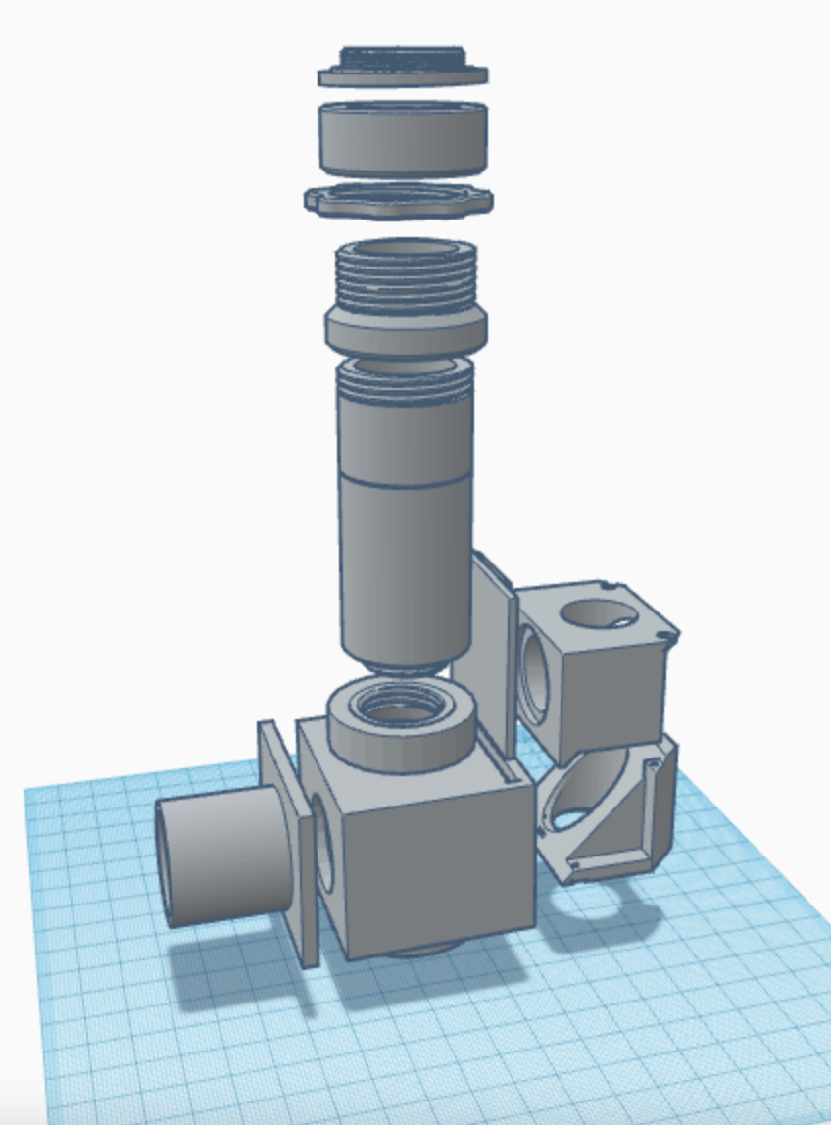
C-Mount Thread (A)
EpiScope
Exploded View
C-Mount Collar (B)
C-Mount Lock Nut (C)
Tube Extender Ring (D)
Microscope Tube (E)
Filter Cube Door (J)
Microscope Tube
Lower Adapter (F)
Filter Cube Top (K)
LED Tube (I)
Filter Cube Bottom (L)
Filter Cube
Holder (G)
RMS Objective
Lens Adapter (H)

